Slide 1


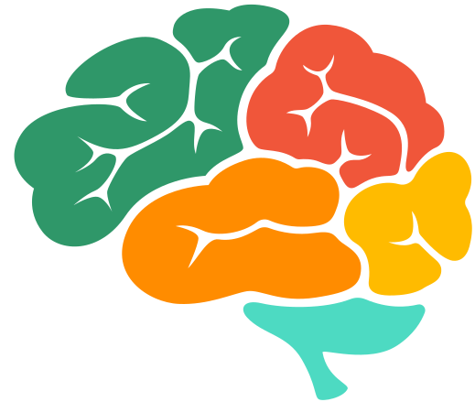




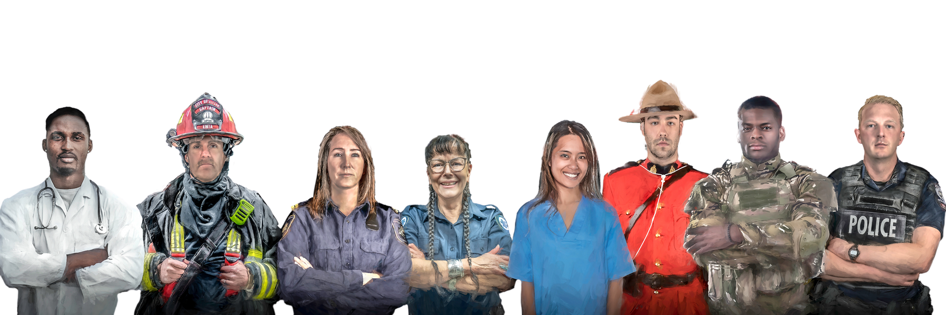




THE ‘BRAIN EVENT’
BY
Website
Feb 6, 2025 8:00 to 4:00 PM
osicandir@cmhask.com
2267 Albert St, Regina, SK

Slide 2
THE BRAIN EVENT BY OSI-CAN
DE-STRESSING YOUR BRAIN
  ‘FLOWPRESSO’

Slide 3
THE BRAIN EVENT BY OSI-CAN
STRESS AND THE BRAIN
The brain’s frontal lobe controls important cognitive skills such as judgement, speech, learning, reasoning, problem solving and memory.
Stress Injuries are essentially an injury to your brain’s cognition, affecting sleep, decision-making, reasoning, problem-solving, and even memory as the Stress Injury activates the Amygdala which kicks up the stress and causes such situations as Hypervigilance

Slide 4
THE BRAIN EVENT BY OSI-CAN
RESILIENCE & RECOVERY
Are you ready to take charge of your brain, body, and overall well-being?
We are thrilled to introduce our suite of advanced wellness tools designed to optimize performance, promote recovery, and support mental clarity for every challenge you face
These technological tools include:
  ‘Flowpresso’

Slide 5
THE BRAIN EVENT BY OSI-CAN
FLOWPRESS0
Experience profound relaxation in just 40 minutes! Flowpresso’s combination of gentle compression and thermal therapy calms your nervous system, reduces stress, and improves circulation. It is an excellent tool for veterans and public safety personnel dealing with chronic pain, anxiety, and sleep disturbances.
Flowpresso is an innovative wellness device designed to promote deep relaxation, improve circulation, and reduce stress, making it particularly beneficial for veterans and public safety personnel. By combining gentle compression, and thermal therapy, Flowpresso helps to calm the nervous system, alleviate physical tension, and support emotional balance. This holistic approach is ideal for addressing the unique challenges many veterans and public safety personnel face, including chronic pain, anxiety, and sleep disturbances. In just 40 minutes, participants can experience a profound shift from a state of stress to one of relaxation, fostering recovery and overall well-being

Slide 6
THE BRAIN EVENT BY OSI-CAN
BENEFITS FOR PERFORMANCE, SLEEP, AND RECOVERY
Modes of healing are all designed to help you optimize performance, recovery, and overall well-being.
They help manage fatigue, reduce stress, and enhance both physical and mental recovery.
Whether it’s boosting focus, easing muscle tension, or getting more restful sleep, these tools have you covered.
These tools also provide lasting relief for those dealing with PTSD symptoms like flashbacks, anxiety, brain fog, and chronic fatigue. By supporting mental clarity and emotional balance, they offer a way to feel more energized, focused, and ready to take on the next challenge—while also promoting a calm mind and better sleep.

